Slide 1

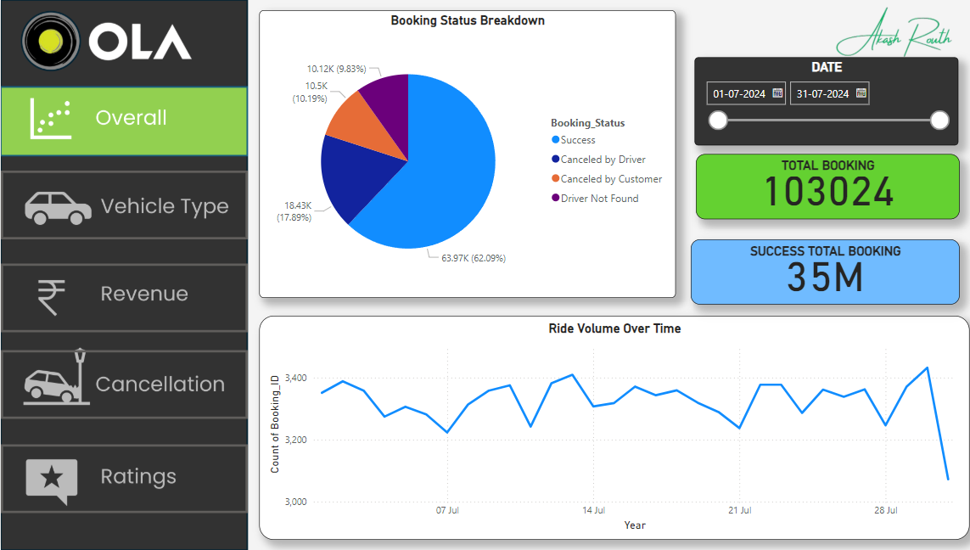
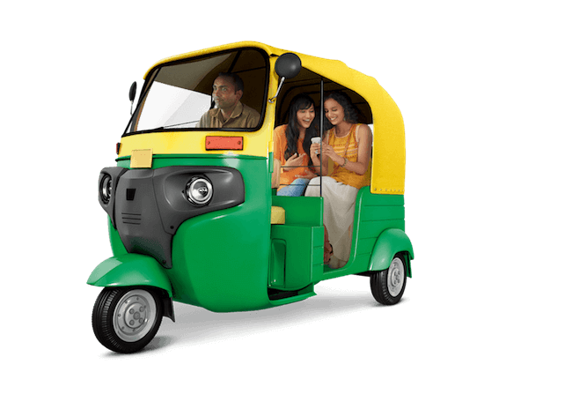
Ola Data Analytics
PROJECT

Slide 2
OVERVIEW :
Make sure orders canceled by customers should not be more than 7%
Make sure orders canceled drivers should not be more than 18%
Also, increase the number of orders on weekends and match days. Keep match day by using the following dates.
keep incomplete rides less than 6%
Keep order value high on weekends
in the Food Category keep around 67 Indian
keep order ID with 10 digits starting with CNR and then digits keep orders under 500 value 70%
keep orders above 500 value 28%
keep remaining orders above 1000

Slide 3
SQL QUESTION:
1. Retrieve all successful bookings:
2. Find the average ride distance for each vehicle type:
3. Get the total number of cancelled rides by customers:
4. List the top 5 customers who booked the highest number of rides:
5. Get the number of rides cancelled by drivers due to personal and car-related issues:
6. Find the maximum and minimum driver ratings for Prime Sedan bookings:
7. Retrieve all rides where payment was made using UPI:
8. Find the average customer rating per vehicle type:
9. Calculate the total booking value of rides completed successfully:
10. List all incomplete rides along with the reason:

Slide 4
POWER BI :
1. Ride Volume Over Time
2. Booking Status Breakdown
3. Top 5 Vehicle Types by Ride Distance
4. Average Customer Ratings by Vehicle Type
5. cancelled Rides Reasons
6. Revenue by Payment Method
7. Top 5 Customers by Total Booking Value
8. Ride Distance Distribution Per Day
9. Driver Ratings Distribution
10. Customer vs. Driver Ratings

